Slide 1
Capstone PROJECT Using CAR DETAILS DATASET
-Snehanjali Pramod Patil

Slide 2
UNDERSTADING THE DATASET USING THE EXCEL

Slide 3
ColUMNS PRESENT INTO THE DATASET
Dataset contains details of 4,340 cars.
name: The name of the car model (string).
year: The year the car was manufactured (integer).
selling_price: The selling price of the car (integer).
km_driven: The total kilometers driven by the car (integer).
fuel: The type of fuel used by the car (e.g., Petrol, Diesel) (string).
seller_type: The type of seller (e.g., Individual, Dealer) (string).
transmission: The type of transmission (Manual or Automatic) (string).
owner: The ownership status (e.g., First Owner, Second Owner) (string).

Slide 4
Some of the insights of the data using the formulas or functions in excel.
SUM of total km_driven (=SUM(A1:D4341) → 2484025821
Maximum value among the selling_price (=MAX(C2:C4341) → 8900000
Minimum value among the selling_price (=MIN(C2:C4341) → 20000
Average of the km_driven by the cars (=AVERAGE(C2:C4341) → 504127.312

Slide 5
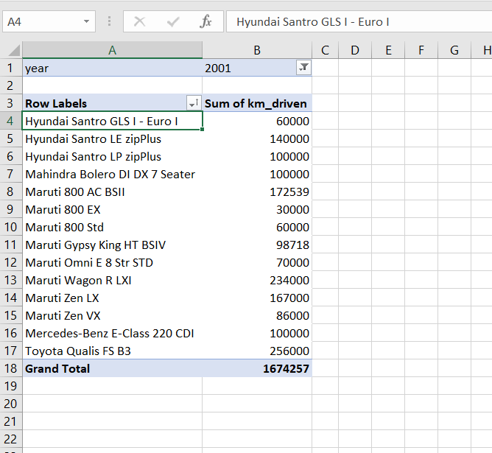
Created the pivot table which shows the in year 2001, sum of distance travelled by each car.

Slide 6
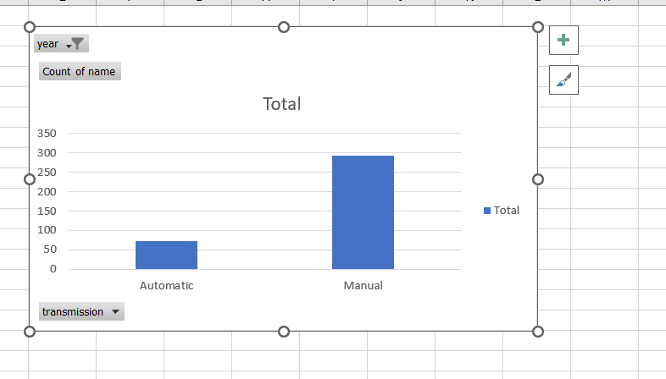
Creating the pivot chart which shows the total count of the automatic & manual cars for the particular year.

Slide 7
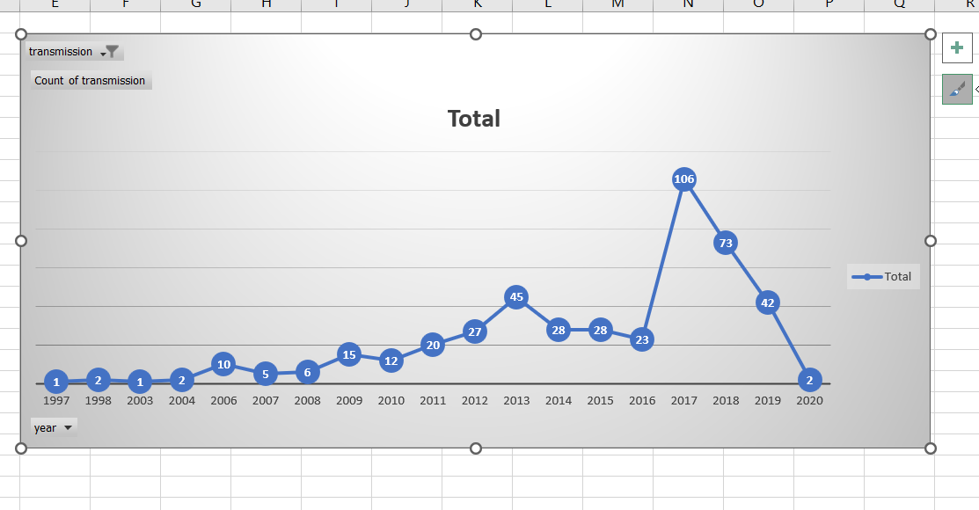
Plotting the yearwise count of the automatic cars.

Slide 8
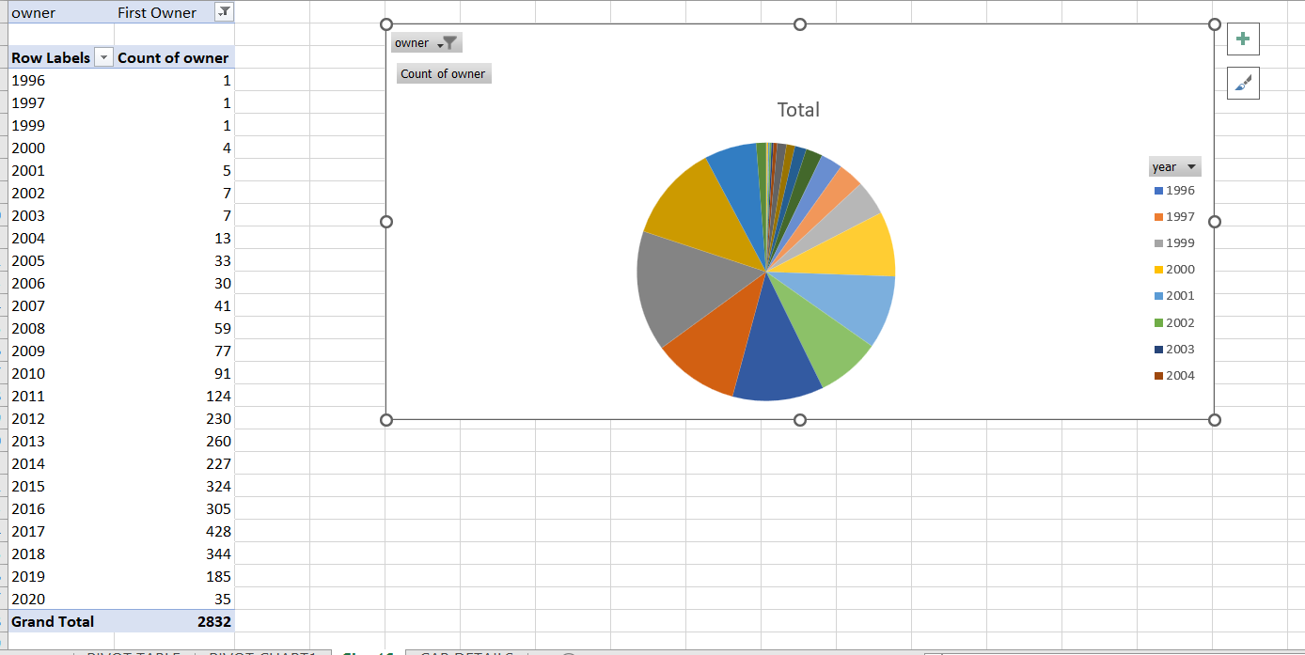
Plotting pie chart to show the yearwise count of first owner car.

Slide 9
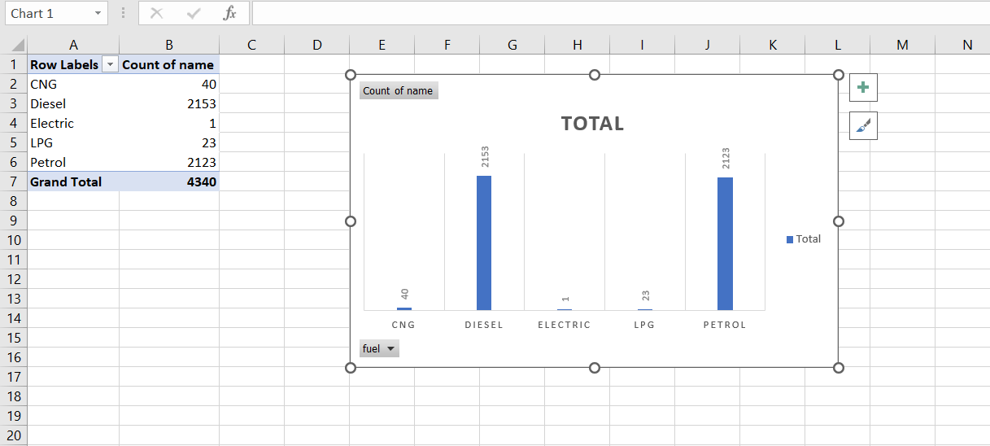
Plotting the count of the type of fuels used by cars.

Slide 10
Key insights that we can conclude from the pivot table & pivot charts created in above slides.
Toyota Qualis FS B3 car has the most km_driven among the whole cars in year 2001.
People prefer the manual car than the automatic car.
The sell of automatic car has increased from year 1997 to 2017 & then decrease from 2017 to 2020.
Most of the car has the first owner than the second & third owner.
Cars which has the petrol & diesel fuel type. They are preferred most.

Slide 11
Data Preprocessing, Cleaning to build the ML Model & to perform EDA using the dataset

Slide 12
Steps performed into it
Handle the Null Value. There is no null value present into the dataset.
Checking of the duplicates. Dropped 763 duplicated rows from the dataset.
Performed the label encoding onto the below columns:-
seller_type
fuel
transmission
owner

Slide 13
Exploratory Data Analysis (EDA) using matplotlib & seaborn

Slide 14
Key insights that we can conclude from the EDA
People mostly uses the disel cars.Electrical cars has least preference among the other type of cars.
Trustmark dealer has sold very less cars.People prefer to buy the car individually instead of buying from dealers.
Manual Cars are preferred more than automatic.
As the value of km_driven increases the selling price of the car will decrease.
Automatic cars has more selling price than manual cars.

Slide 15
Key insights that we can conclude from the EDA
For each & every year there is the outlier value for selling price & from 1997 to 2020 the selling prices has been increased.
Average of selling price increases from 1997 to 2020 & avearge of km_driven deacreses from 1997 to 2020.
Test drive car owner has the highest selling price & then the first owner has the 2nd highest selling price.

Slide 16
Building of the ML Model (Regression Model)
Problem Statement:- Predict the selling price of the car using the year, km_driven, fuel, seller_type, transmission & owner columns.

Slide 17
Steps followed to build the model
Pre-processing of the data. (Label-Encoding, Handling Null Values, Feature Scaling)
Selecting the dependent & independent Variables.
Splitting the data into the training & testing.
Applied the various regression algorithm like linear regression, KNN regression, Lasso Regression, Ridge Regression.
Evaluated the each & every model using the regression metrics.
Selected the best model & saved it.

Slide 18
Important links
GitHub Project Link:-
snehanjali58/capstone-project-using-car-details-dataset: Data Science project which performs EDA & Build the Machine Learning Model. (github.com)
Streamlet app link:-
https://kyhat9rp6d6juezkzgl3mc.streamlit.app/

Slide 19
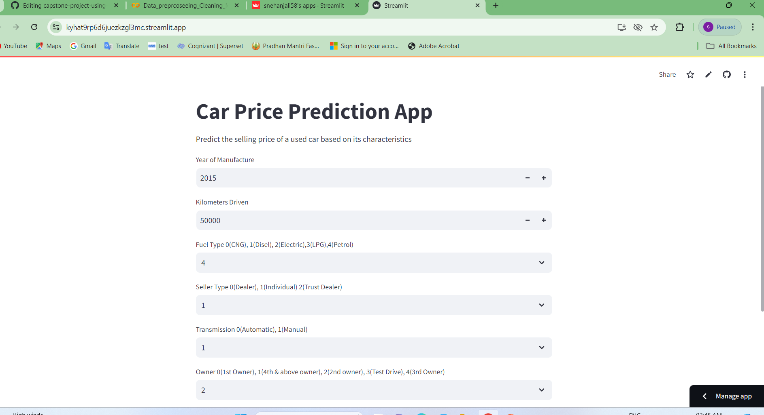
Screenshot of the streamlit app

Slide 20
